Slide 1
Developmental Services
Compliance
Training Package for Adult Protective Services and Employment Supports
July 2018

Slide 2
Compliance Inspections
Training Objectives
To gain an understanding of how the compliance inspection process works.
This training will:
  Provide an overview of the Ministry’s legislated authority
  Highlight the compliance inspection process in an easy to understand manner
  Walk you through each step of the process and identify the tools, resources and supports that are available to you
  Clarify what you need to do prior to, during and after the compliance inspection
  Clarify public posting requirements
  Clarify timelines and enforceable action based on the risk rating of each requirement, and
  Increase your knowledge of and compliance with the requirements outlined in Ontario Regulation 299/10 regarding Quality Assurance Measures (QAM) and the Policy Directives made under the Services and Supports to Promote the Social Inclusion of Persons with Developmental Disabilities Act, 2008 (SIPDDA).

Slide 3




Ministry’s Authority to Monitor Quality Assurance
O. Reg. 299/10 Quality Assurance Measures + Policy Directives
  The ministry’s authority to monitor quality assurance:
  All agencies and DSOs funded under the Services and Supports to Promote the Social Inclusion of Persons with Developmental Disabilities Act (SIPDDA) are legally required to comply with minimum quality standards laid out in regulations and policy directives that accompany the Act.
  The quality standards aim to promote social inclusion, individual choice, independence and rights for adults with developmental disabilities, as well as to protect the health and safety of people who are in vulnerable situations.
  The ministry monitors agency adherence to the standards by conducting regularly-scheduled and unscheduled compliance inspections.
  The ministry has the authority to enforce compliance with the legislated requirements using methods prescribed in the legislation.
  The quality assurance standards and the ministry’s compliance regime do not apply to agencies/services funded under other legislation (e.g. the MCCSS Act).
  Source Documents:
  Services and Supports to Promote the Social Inclusion of Persons with Developmental Disabilities Act (SIPDDA)
  O. Reg. 299/10 Quality Assurance Measures
  Policy Directives for Service Agencies
  Policy Directives for Agencies Regarding the Host Family Program
  Policy Directives for Application Entities
In Scope:
240+
Transfer Payment Agencies (funded under SIPDDA)
~ 2500+
Residential Sites
10
Residential and community-based service types
9
Development Services Ontario offices (DSOs)

Slide 4
Overview of Compliance Inspections
THE ACT - The Services and Supports to Promote the Social Inclusion of Persons with Developmental Disabilities Act, 2008 (SIPDDA)
Provides the legislative framework for MCCSS funded adult developmental services in Ontario, and includes the regulation on quality assurance measures and the power to issue policy directives.
INSPECTIONS
Purpose
Assess agency compliance with legislation and policy directives
Communicate compliance requirements
Provide agencies with assistance to become compliant
2 Types
Service Agency
DSO
Look at:
Individual support plans
Management of individual finances
Health promotion
Medical services and medication
Abuse prevention, and reporting
Confidentiality and privacy
Health and safety
Human resource practices and staff and board records

Slide 5



Overview of Compliance Inspections –
Limitations of Powers & Determining Eligibility
Types of Inspections
Paper based
We review the quality of documents, however we cannot verify the contents of written materials or evaluate policies and procedures outside of QAM.
Physical
We assess the provision of health & safety conditions in residential homes.
Inspectors make recommendations to enhance service delivery
Not all Ministry funded DS programs are eligible for inspection. For example:
  Programs that are not funded under SIPDDA.
  Agencies that do not directly deliver services and supports.
  Outside paid resources.

Slide 6








DS Compliance Overview
The steps of a compliance inspection
Notification Letter
Entrance Meeting
Exit Meeting
& Sign Off
Inspection
Start
Step 1
Agencies receive a notification letter 2-3 weeks prior to inspection
Step 2
Program Advisor (PA) will met with agency and identify scope of inspection
Step 3
File review
Step 4
Review results
Highlight risk ratings
Communicate timelines
Public
Posting
Within
10 Days
Submit Compliance
Action Template
Compliance
Results
Finish
Step 8
Agency posts letter of compliance/non-compliance on site
Step 7
Submit CAT to ministry Detail action for high & timelines for low/mod
Step 6
Agency completes CAT Rectify high non-compliance(s)
Step 5
PA provides compliance results & CAT to agency
Notes:
For Employment Support, is a site visit required?

Slide 7
DS Compliance Framework
Compliance Support
The intention is that service agencies achieve compliance prior to inspection.
Information, support and resources are available to assist service agencies to understand the requirements and evidence required to meet MCCSS expectations.
Encourage service agencies to support one another to assist with compliance inspections.
Compliance Process
Enforcement (if necessary)
Inspection occurs
On going support and resolution mechanism available to clarify compliance requirement
Provide timelines to service agency to achieve compliance
Post inspection results at 10 day mark (or earlier if compliant)
Notice of Compliance Order
10 days for high risk
40 days for low or moderate risk
Compliance Order
Director to establish timeframe to achieve compliance
Extreme cases of persistent non-compliance:
Immediate takeover
(s. 31)
Termination of funding (s.30(7))
Note: ‘Days’ will be normally be ‘business days’ unless otherwise indicated

Slide 8
Compliance Support
Notice of Inspection
A notice of inspection letter will be forwarded to Executive Director/Chief Executive Officer, copying the President of the Board of Directors and the MCCSS Program Supervisor, three weeks prior to the compliance inspection.
The notice of inspection letter contains:
    Date, time and location of entrance meeting
    Who is required to participate
    The purpose of compliance inspections
    The list of documents to be made available for the inspection
    A copy of the inspection report detailing the Regulation 299/10 and Policy Directives that apply to the service agency
    A tip sheet offering suggestions for preparing for an inspection
In addition to the inspection report, the letter and tip sheet identify key compliance resources. These include, for example:
    DS Compliance Indicator List
    QAMClear
  All of these resources can be found on the QAM website at www.qamtraining.ca.

Slide 9
Compliance Support
Indicator List / Program Requirements
The Developmental Services Compliance Indicator List (“Indicator List”) is the primary tool the Developmental Services Compliance Team uses to support service agencies and help them understand the program requirements. It will also help in interpreting the “indicators” that Program Advisors use to assess and confirm compliance during inspections.
The Indicator List should to be used in conjunction with the Compliance Inspection Report.
Sections were designed to reflect the order that they appear in the Compliance Inspection Report.
The Indicator List includes information on:
    The policy intent of the requirements
    Applicability of the requirements to SIPDDA-funded services and supports
    Differing severity of non-compliant requirements
    Specific indicators used to assess and confirm compliance during inspections
    Service agency actions required to meet the requirements
The Indicator List is not intended to replace legal advice that the service agency may need to seek with regard to compliance with the requirements.

Slide 10
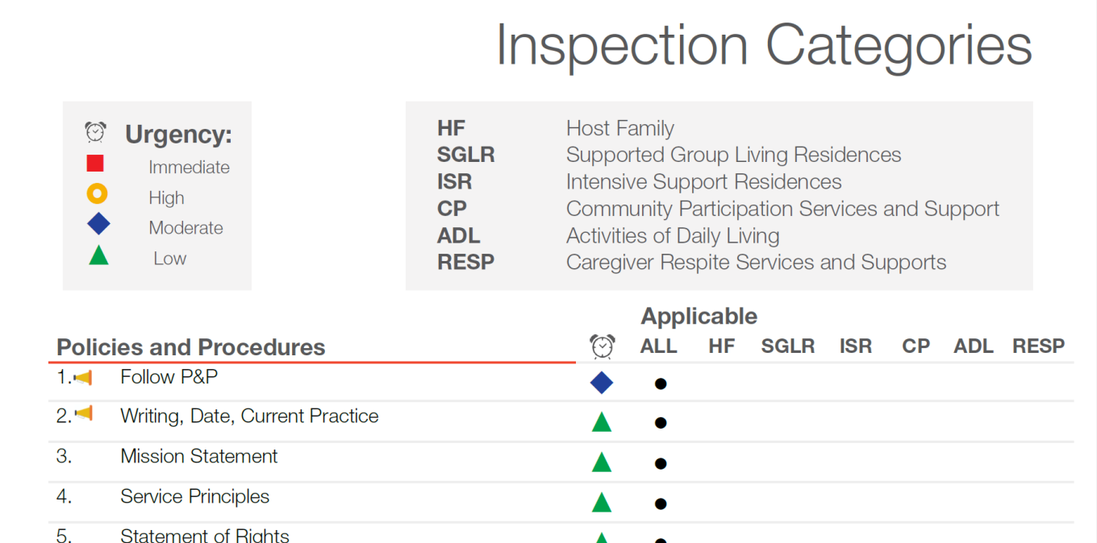
Compliance Support
Indicator List / Program Requirements cont’d
  The indicators show how Regulation 299/10 and Policy Directives requirements are applied to SIPDDA-funded services and supports (please note: if a program does not have its’ own section then the “ALL” column applies).
  Adult Protective Services and Employment Support Programs are required to comply with the requirements listed under the “ALL” column.

Slide 11
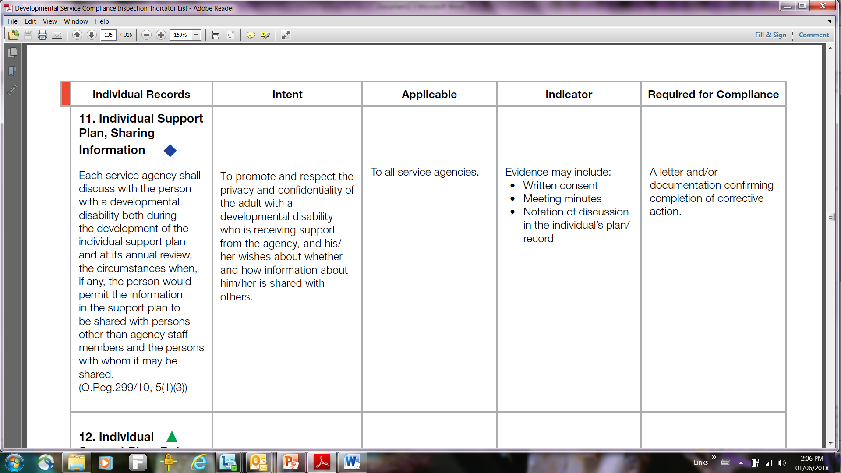
Compliance Support
Indicator List / Program Requirements cont’d
INTENT
  The section on intent outlines the rationale for each requirement under the legislation and the Policy Directives.
  It highlights the colour coded risk ratings for each requirement.
INDICATORS
  The indicators on the list, although not exhaustive, specify methods that the service agency may use to show or indicate compliance with the sections of the legislation and policy directives.

Slide 12
Compliance Support
QAMClear
The ministry has prepared a supplemental tool, “QAMClear,” to guide Program Advisors, Program Supervisors and agencies in addressing specific issues or questions.
This tool should reduce varying interpretations on the intent of regulations, or differences in what is required to meet compliance as well as changes which may occur in compliance status between inspections.
QAMClear includes the following information:
  QAM or policy directive requirements
  Intent of the requirement
  Issue identified as a result of the analysis and the feedback from the sector
  Operational Guidance - evidence for compliance or non-compliance.
QAMClear is accessible on the QAM website (www.qamtraining.net) and will be updated as necessary.

Slide 13
Compliance Support
QAM Website
The following reference documents to assist service agencies funded under Adult Protective Services and Employment Supports in preparing for the compliance inspection, are available on the QAM website.
QAM web site: http://qamtraining.net/files_english.html
    Some key tools on the site you should be familiar with are referenced below:
Developmental Service Compliance Inspection: Indicator List
  The Indicator List is the primary tool the Developmental Services Compliance Team uses to support service agencies and help them understand their responsibilities under SIPDDA, Quality Assurance Measures and the Policy Directives.
Developmental Services Comprehensive Inspection List for Employment Support and Adult Protective Services Programs
  Complete list of all 145 applicable requirements.
Compliance Tip Sheet
  The tip sheet provides suggestions to assist service agencies to achieve compliance in advance of an inspection. The tip sheet will normally accompany an inspection notice.

Slide 14
Compliance Support
Additional Resources
MINISTRY PROGRAM ADVISOR
Program Advisors are responsible for:
  Conducting agency based inspections, evaluating and monitoring the operations of agencies to ensure compliance with legislative standards;
  Identifying issues and making recommendations for corrective action/improvements;
  Providing clarification to service agencies on the inspection process and timelines; and
  Communicating the ministry’s expectations for strengthening compliance across the Developmental Service sector.
MINISTRY PROGRAM SUPERVISOR
Program Supervisors manage the service contracts with agencies and are responsible for monitoring and supporting agencies to be compliant with the QAM requirements.

Slide 15
Compliance Support
Additional Resources
COMMUNITY TABLES
  Agency mentorship
  Sharing policies and procedures, best practices, operation templates and resources
UMBRELLA AGENCIES and NETWORKING OPPORTUNITIES
  PROVINCIAL NETWORK
    Provide expertise, feedback and advice
    QAM subject experts
  COMMUNITY LIVING ONTARIO
    Represents 107 local Community Living associations across Ontario
  ONTARIO AGENCIES SUPPORTING INDIVIDUALS with SPECIAL NEEDS (OASIS)
    Provides leadership through sharing ideas, information and knowledge

Slide 16
Compliance Improvement
What Do We Inspect
There are 145 requirements under Regulation 299/10 supporting Policy Directives that apply to Adult Protective Services and Employment Services:
  Policies and Procedures = 45
  Board Records = 9
  Staff – Volunteer Records = 18
  Individual Records = 40
  Records and Documentation = 33
Compliance inspections typically include:
  Review of some staff member files (includes full-time, part-time, relief and casual staff)
  A sampling review of files, including Individual Support Plans for individuals receiving services and supports
  A review of Incident and Occurrence Reports
  Confirmation of completion of staff training requirements
  Review of individuals’ financial records (if applicable)
  Review of Health & Safety Records, Reports and Checklists
  Review of maintenance and equipment records

Slide 17





Compliance Inspections
Current Environment & Key Facts
Authority to inspect up to
350 requirements
219 DS Transfer Payments Agencies inspected annually
SIPDDA
Quality Assurance Measures Reg. | Policy Directives
up to 279 | Intensive support residences (ISR)
up to 279 | Supported group living residences (SGLR)
up to 226 | Community participation services and supports (CP)
up to 211 | Caregiver respite services and supports
up to 204 | Host family residence (HF)
up to 145 | Supported independent living (SIL)
up to 145 | Employment supports (ES)
up to 145 | Adult Protective Services
up to 146 | DSOs
9 DSOs inspected on a 3 year cycle.
~2500 Residential sites inspected on a 3 year cycle
~17,900 Individuals receiving supports and services
9 Program Advisors
* The number and content of requirements may vary depending on the types of services and supports that are in scope for the inspection.

Slide 18
Compliance Improvement
Inspection Activities
Entrance meeting
Inspection
Exit meeting and sign off
Compliance results
Submitting CAT to Ministry
Within 10 Days post inspection
Review inspection scope with the service agency and initiate the process (e.g. review Policies and Procedures, Board Records, Staffing Records, Individual Files and Records and Documentation)
File Review
Review preliminary inspection results, highlight risk ratings, and communicate timelines for completion with the service agency
Ministry will provide a written compliance summary to the service agency within one business day: Compliance Letter and Inspection Report, or Non-Compliance Letter, Summary Report and the Compliance Action Template (CAT)
Within 24 hours of receiving the Non-Compliance Letter, the service agency shall return the CAT to the ministry - must address HIGH non-compliance(s)
The service agency shall submit the CAT to the ministry, describing the corrective action for all HIGH non-compliances, and timelines for LOW/MODERATE non-compliances that are not corrected
Public Posting

Slide 19
Compliance Improvement
What to Expect at an Entrance Meeting
The Program Advisor will conduct an entrance meeting with the service agency to review the inspection scope and initiate the process:
Describe the purpose of compliance inspections for service agencies receiving funding under SIPDDA.
Confirm inspection schedule for employment services.
Identify random selection of staff and volunteer records for sites/programs designated for inspection.
Discuss post-inspection non-compliance follow-up activities and timelines. Remember to address High rated non-compliances first.
        High rated non-compliances are to be rectified within 10 business days.
Discuss available compliance supports and address any service agency questions.
Schedule the exit meeting to discuss inspection findings, trends, best practices and clarify expectations and specific timelines based on the severity of non-compliances.
WHY?

Slide 20
Compliance Improvement
What to Expect at an Exit Meeting
Review inspection results:
  Highlights of organizational best practices
  Review areas of non-compliance
  Description of risk rated non-compliances and timelines to address non-compliances
  Sign off on compliance inspection reports if all parties are in agreement with the contents of the inspection report. If the agency does not agree with the inspection findings they do not have to sign. In cases of disagreement it is recommended that an inquiry be submitted to DSCompliance.ca.
Upon completion of the inspection, the service agency will be deemed either compliant or non-compliant.
Compliant
  The Compliance Letter and Inspection Report will be sent within 24 hours to the service agency’s Executive Director, c.c. Board Chair and c.c. Regional Program Supervisor. The Inspection Report outlines all QAM and policy directive requirements and includes additional notes.
  No further action is required.

Slide 21
Compliance Improvement
What to Expect at an Exit Meeting cont’d
Non-Compliant
  The Non-Compliance Letter, Summary Report and Compliance Action Template (CAT) will be sent within 24 hours to the service agency`s Executive Director, c.c. Board Chair and c.c. Regional Program Supervisor.
  The Summary Report outlines all non-compliances and includes what is required for compliance with the Regulation 299/10 QAM and policy directive requirements.
  The CAT will be completed by the service agency to provide the corrective measures and to confirm completion of the non-compliance requirements or an action plan to address how the agency will address the non-compliance(s).
Contact your ministry Program Advisor/Program Supervisor for all inquiries which specifically relate to an inspection. The DS Compliance email address is available throughout the year for any compliance queries and can also be accessed during an inspection, if further clarification is required for information/decisions provided by the Program Advisor or Program Supervisor.

Slide 22
Compliance Improvement
Compliance Reporting Timelines
HIGH
Within 24 hours of receipt of Non-Compliance Letter, the service agency shall return the CAT to the ministry to address non-compliances rated HIGH. Action plans shall also include whether the service agency will complete corrective action within 10 business days or if the agency anticipates any issues with meeting the timelines.
Within 10 business days, the service agency shall submit a copy of the CAT to the Ministry describing the completion of corrective action.
LOW TO MODERATE
Within 10 business days, the service agency shall submit a copy of the CAT to the Ministry describing the completion of corrective action.
Within 30 business days of receipt of the Post Inspection Follow Up for Outstanding Low to Moderate Requirement Letter, the service agency shall submit a copy of the CAT to the Ministry describing completion of corrective action.

Slide 23
Compliance Improvement
Public Posting
Service agencies are required to post a hard copy of the Letter of Compliance or Non-Compliance that is issued by the ministry following a compliance inspection.
  A Compliance or Non-Compliance Letter shall be sent to the agency for posting if the service agency remains in non-compliance 10 business days post exit meeting.
  The most up-to-date Compliance Letter or Non-Compliance Letter shall be displayed in a prominent location within the service agency’s main entrance, where it is easily visible to the Ministry Program Advisor and the general public.
  The Compliance or Non-Compliance Letter is to be posted within three business days of receipt from the ministry.
  The Compliance or Non-Compliance Letter is to remain posted until the completion of a subsequent compliance inspection (or when the ministry sends someone to confirm compliance has been achieved).
Service agencies that remain in non-compliance and follow the timelines for correcting non-compliance requirements the Director (under SIPDDA) deems not solely within their control to rectify, will receive a separate Non-Compliance Letter with an explanation.
  The explanation will indicate that the service agency is in non-compliance for reasons not solely within their control and is being monitored by the ministry.

Slide 24
Enforcement
Process and Timelines
The ministry will act reasonably before taking enforcement action (e.g. consider whether non-compliance with a requirement is within the service agency’s sole control to rectify).
If an agency fails to comply, a Director appointed under SIPDDA could issue a compliance order.
  The appointed Director would review the inspection file and circumstances to determine if a compliance order is warranted and/or reasonable.
  Before issuing a compliance order, the Director must provide notice of the proposed order, reasons for it, and the time frame for compliance. The timelines for compliance would be based on circumstances and outlined in the notice.
  A Notice of Compliance Order will identify what is required in order to achieve compliance and by what date this must be completed.
  The service agency will have 14 calendar days or other time period specified in the notice (e.g. 10 business days) to respond with evidence of compliance or provide a written submission before a compliance order may be issued. The appointed Director may reconsider the decision to issue an order at this time.

Slide 25
Enforcement
Process and Timelines cont’d
  A Director may issue a Compliance Order after considering a submission, or if no submission was received, after the time period required in the notice has expired.
  If a service agency fails to comply with a compliance order, the ministry could terminate the funding agreement, and/or in extreme circumstances (in accordance with grounds under the Act) a failure to comply could result in an immediate takeover.
  In the case of a Developmental Services Ontario (DSO) application entity, the Minister may revoke their designation. The ministry could also terminate funding or initiate a takeover (in accordance with grounds under the Act).
  The ministry may withhold “new” MCCSS funding for adult developmental services or initiatives in the event that a compliance order is issued. Examples of “new funding” currently include:
    In-year funding enhancements
    Any special initiatives (e.g., Employment and Modernization Fund (EMF)).

Slide 26
Compliance Improvement
Issue Dialogue and Resolution
The ministry has developed an informal issue dialogue and resolution mechanism for service agencies to contact the corporate developmental services compliance team to:
  Address any issues that may arise during the compliance inspection process, and/or
  Clarify the intent of the QAM requirements and Policy Directives under SIPDDA.
As issues are resolved, the Compliance Team will identify both the issue(s) and resolution(s) on the QAM training website and in the QAMClear for your future reference, as appropriate.
Issue dialogue and resolution inquiries must be submitted in writing by the service agency to DSCompliance@ontario.ca
Inquiries should have a clear objective (e.g., the purpose is to clarify directions for compliance or provide feedback on the requirements and policy directives).

